Slide 1

R vision for HTA R-consortium HTA-WG
Christian Haargaard Olsen

Slide 2

Who
Karolin Struck – Smartstep consulting
Robert Smith – DarkPeakAnalytics
Rose Hart – DarkPeakAnalytics
Natalie Dennis – Daiichi Sankyo
Christian Haargaard Olsen - Novo Nordisk

Slide 3
Vision
Regulatory statistics is enjoying the flourishing of a wide ecosystem of R packages to support regulatory submissions.
It is now possible to do a complete regulatory submission in R using open-source packages.
Our goal is to have the same possibility for HTA submissions.
However, we envision our journey there to be more direct by having a framework laid out for needed components and how they fit together as well as concerted cross-industry efforts to fill the gaps.

Slide 4
Approach
Getting organized
Mapping out tasks
Goals for solution/vision
Actionable
Modular: extendable, replaceable, buildable
Support automatic pipelines
Robust
Reduce points of human input
Organising into components
Present – for you
Present - externally

Slide 5
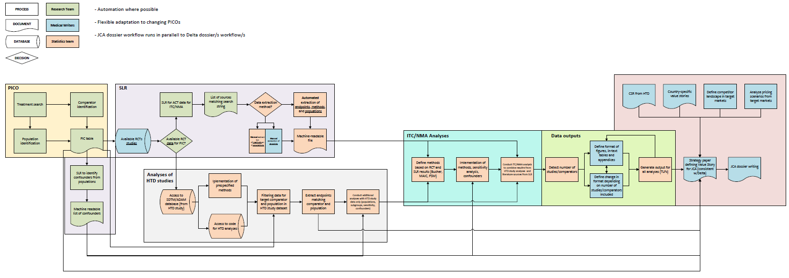
JCA process

Slide 6
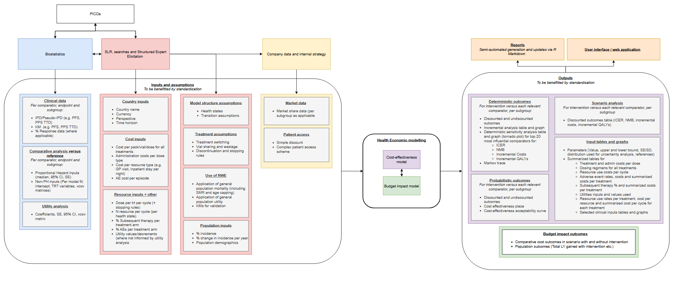

Slide 7
Multi-dimensional requirements
Support typical processes
Must support the way people are working with the processes
Modular
Specified interfaces allows separating concerns
Extendable, replaceable, buildable

Slide 8
Multi-dimensional requirements
Dependency tracking
Must go through the pipeline and thus across components.
Work in iterations
Human inputs
Clear modules/interfaces for human decisions/input
Validation
Packages
Combined setup

Slide 9

Simple example
RAMNOG – R suite for facilitating AMNOG style analysis
Takes specifications in specific format, outputs results in defined format
Splits orchestration, analysis and criteria into different modules
and leaves out presentation for now
Tracks dependencies
Reruns analysis where input has changed, leaves others unaltered.
Allows iterative building of delivery package

Slide 10



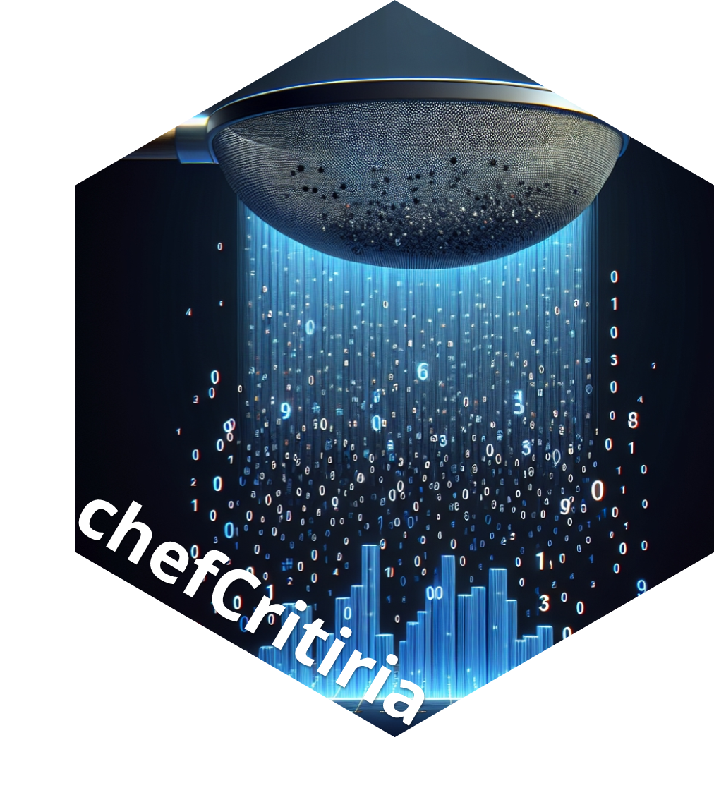
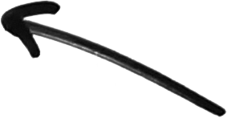





Specifications
Formatted
output
Results
Data
Notes:
chefStats package as the library of statistical methods.
Here we’ll look at how these methods interface with the core chef package, and how user’s can add their own functions

Slide 11
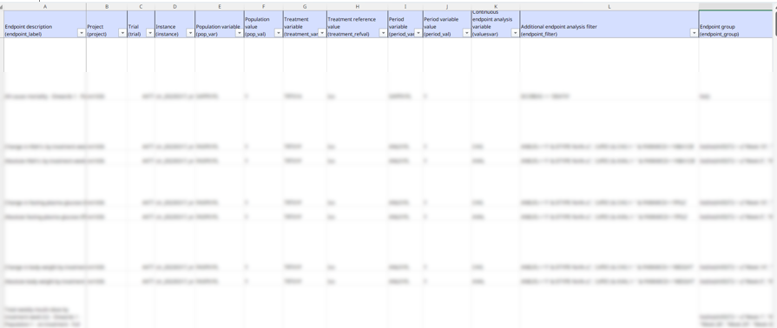
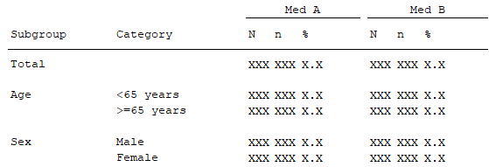

Slide 12



